Slide 1



Why is building and running microservice apps hard?
Complex architectures
Cross-platform portability
Enforcing
best-practices
Troubleshooting
experiences

Slide 2




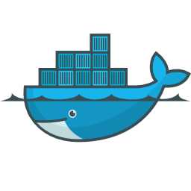
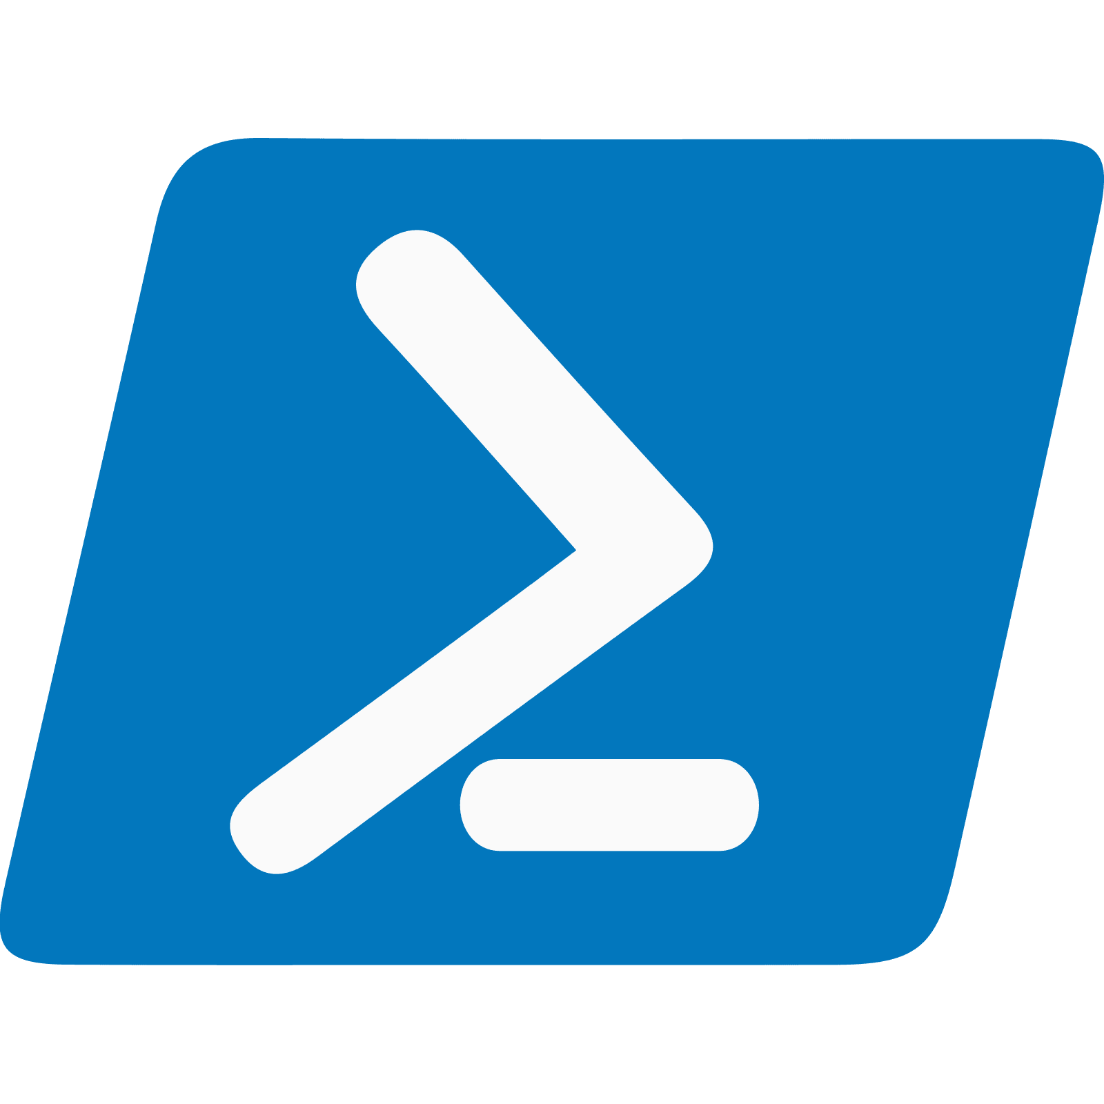



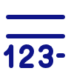

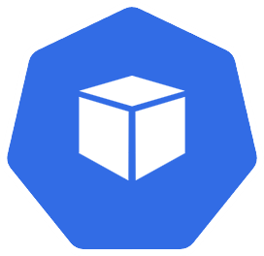

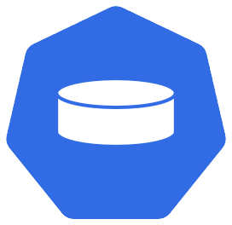
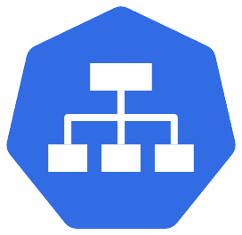

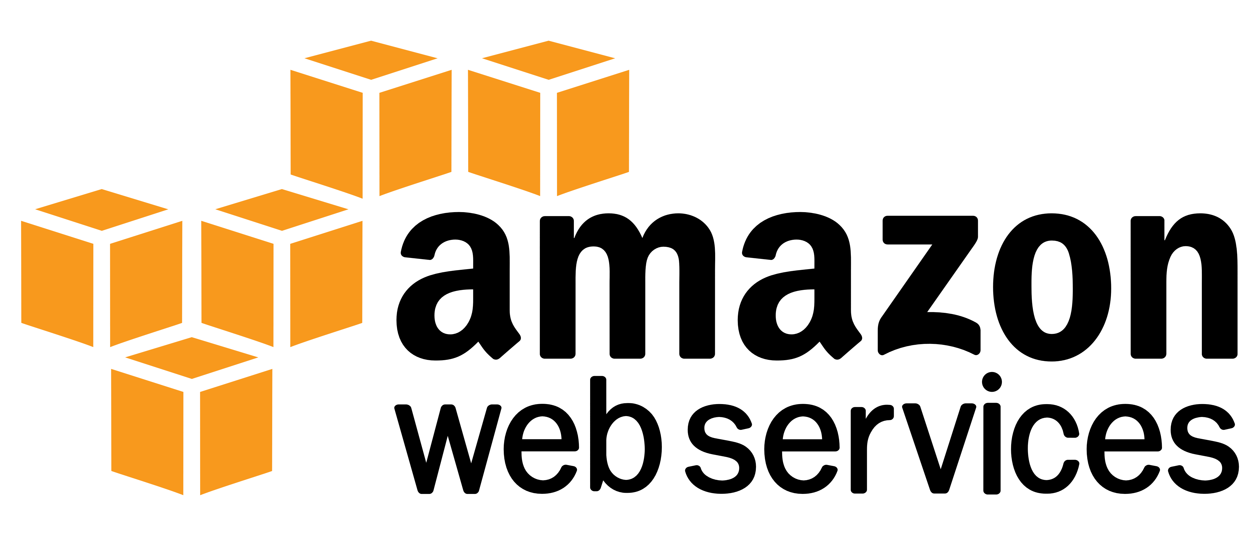


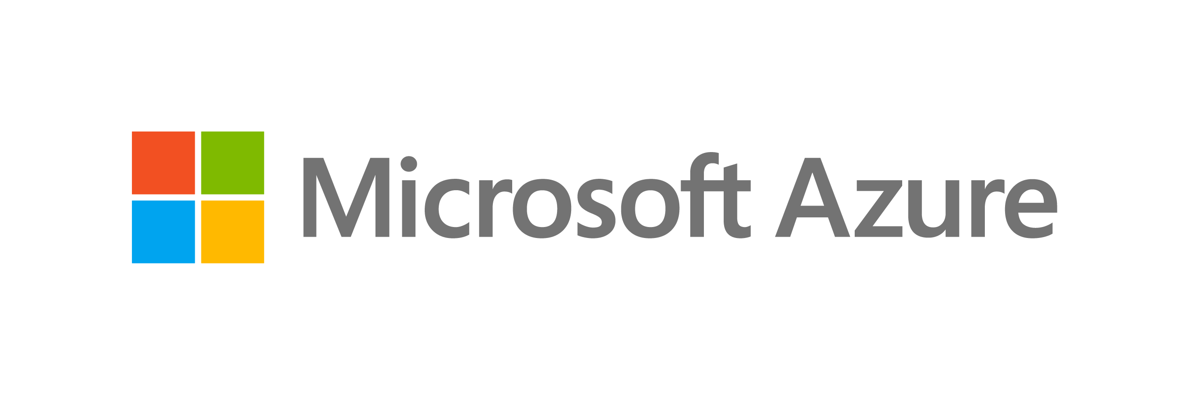
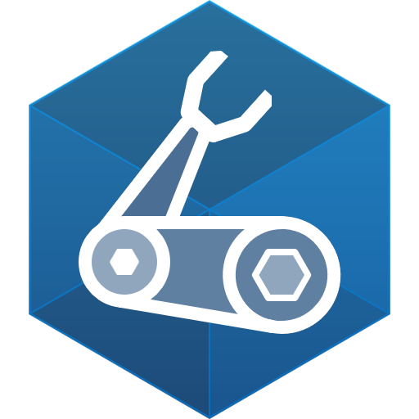

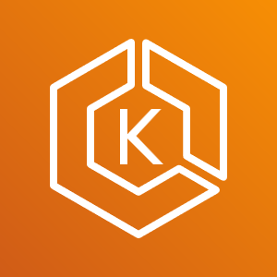





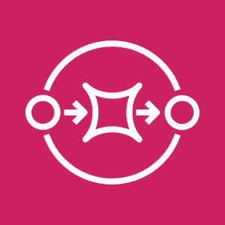
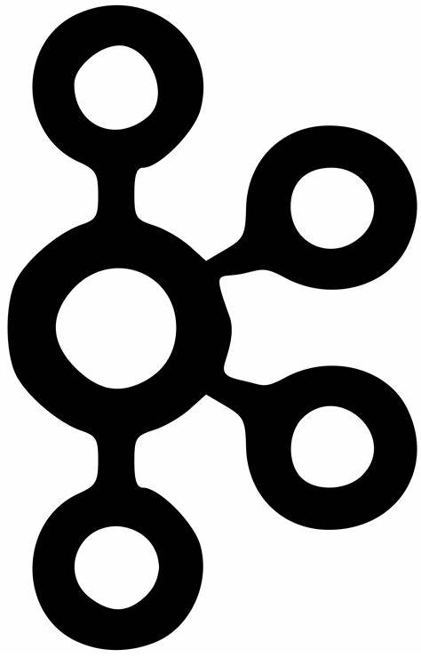
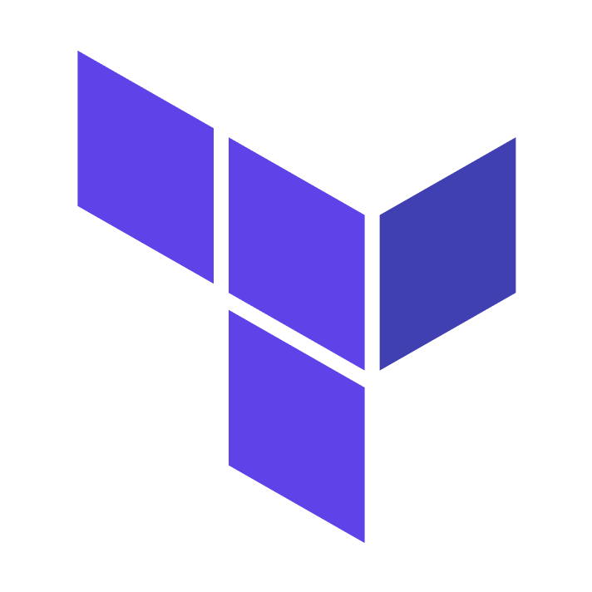



Cloud native apps are more than just
...
Base image
Code
Ports
Entrypoint
Dockerfile
...
PowerShell
Registries
Charts
Releases
Parameters
...
Pods
Secrets
Volumes
Services
Bash
On-premises
AKS
EKS
Machines
Bicep
Blob storage
S3
Disk
GitHub Actions
Event Hubs
SQS
Kafka
CosmosDB
DynamoDB
MongoDB
...
...
...
Terraform

Slide 3
Cloud-native application platform
that works on any cloud

Slide 4
Team
Collaboration
Infrastructure Recipes
Application
Graph
Cloud
Neutral
Radius Application and Environments allow developers to work with operations on application definition + delivery
Swappable infrastructure with popular IaC tools that follows org best practices and IT policy
by default
Understand
how services and infrastructure in an application are interconnected
Deploy across development, on-premises, and cloud environments with a consistent experience

Slide 5

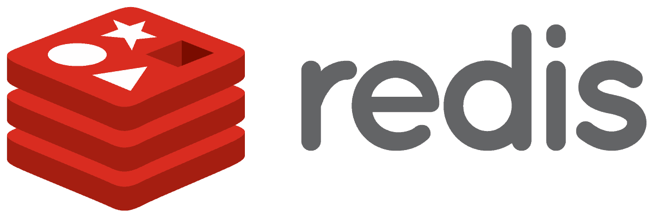
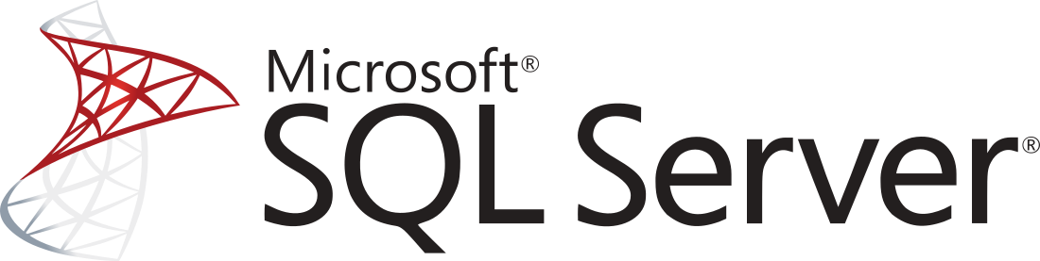




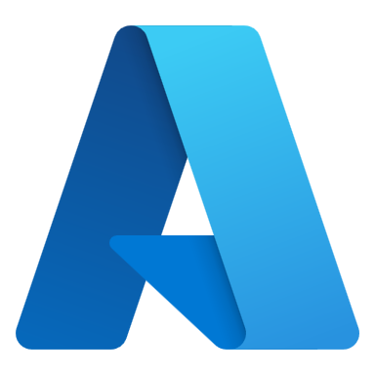
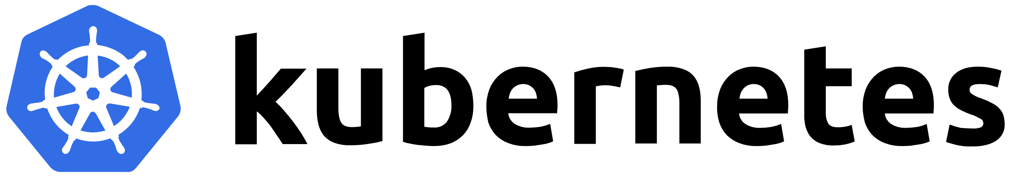


Cloud-native applications
containing
Team
Collaboration
Infrastructure Recipes
Application
Graph
Cloud
Neutral
Any cloud or edge infrastructure

Slide 6

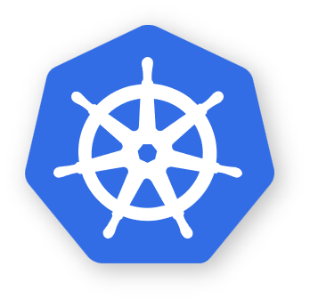

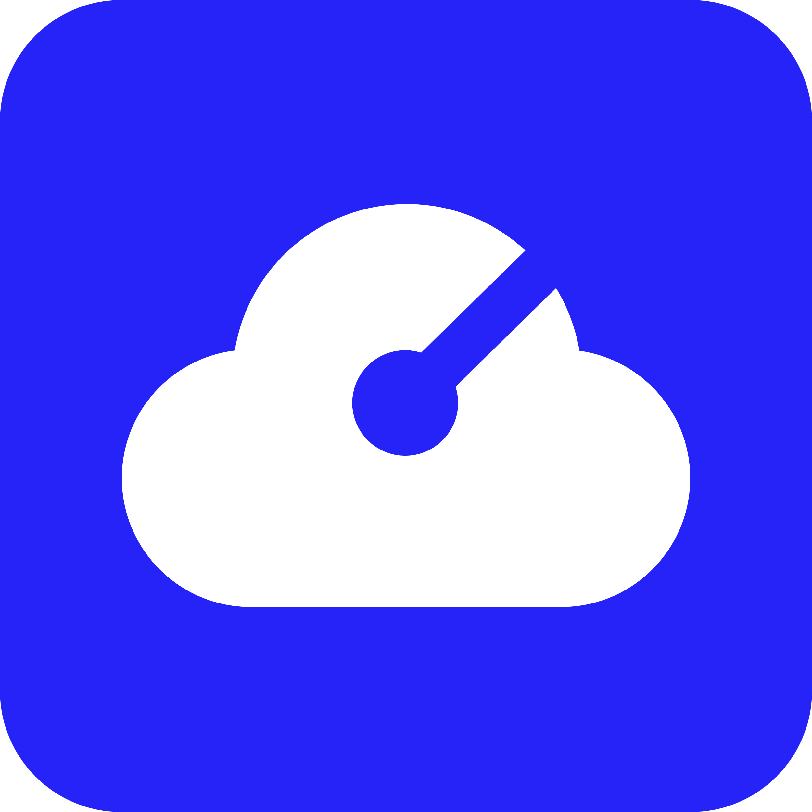







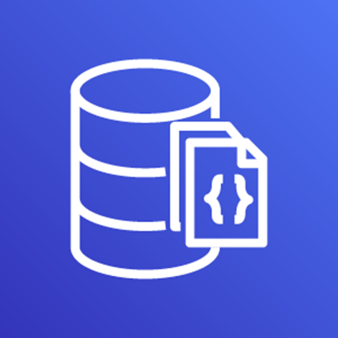

Environment
RECIPES
Redis
Container
SQL
Container
Local development
COMPUTE
CNCF-certified
Kubernetes
Application
Environment
Internet
Gateway
RECIPES
Azure Cache
for Redis
Azure
SQL DB
Frontend
Container
RECIPES
Backend
Container
Redis
Cache
COMPUTE
Azure
Kubernetes Service
SQL
Database
Environment
RECIPES
AWS
MemoryDB
AWS
DocumentDB
COMPUTE
Elastic
Kubernetes Service

Slide 7
Building our first Radius App

Slide 8



radapp.io
aka.ms/radius/discord
github.com/radius-project

